Slide 1
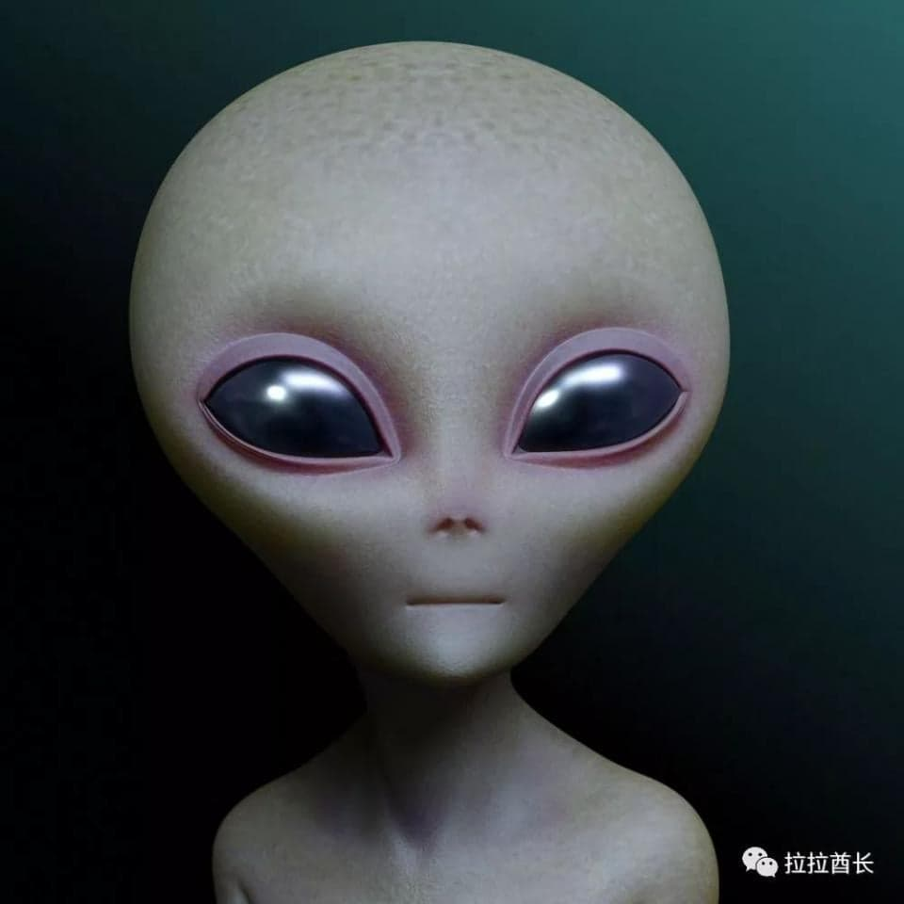
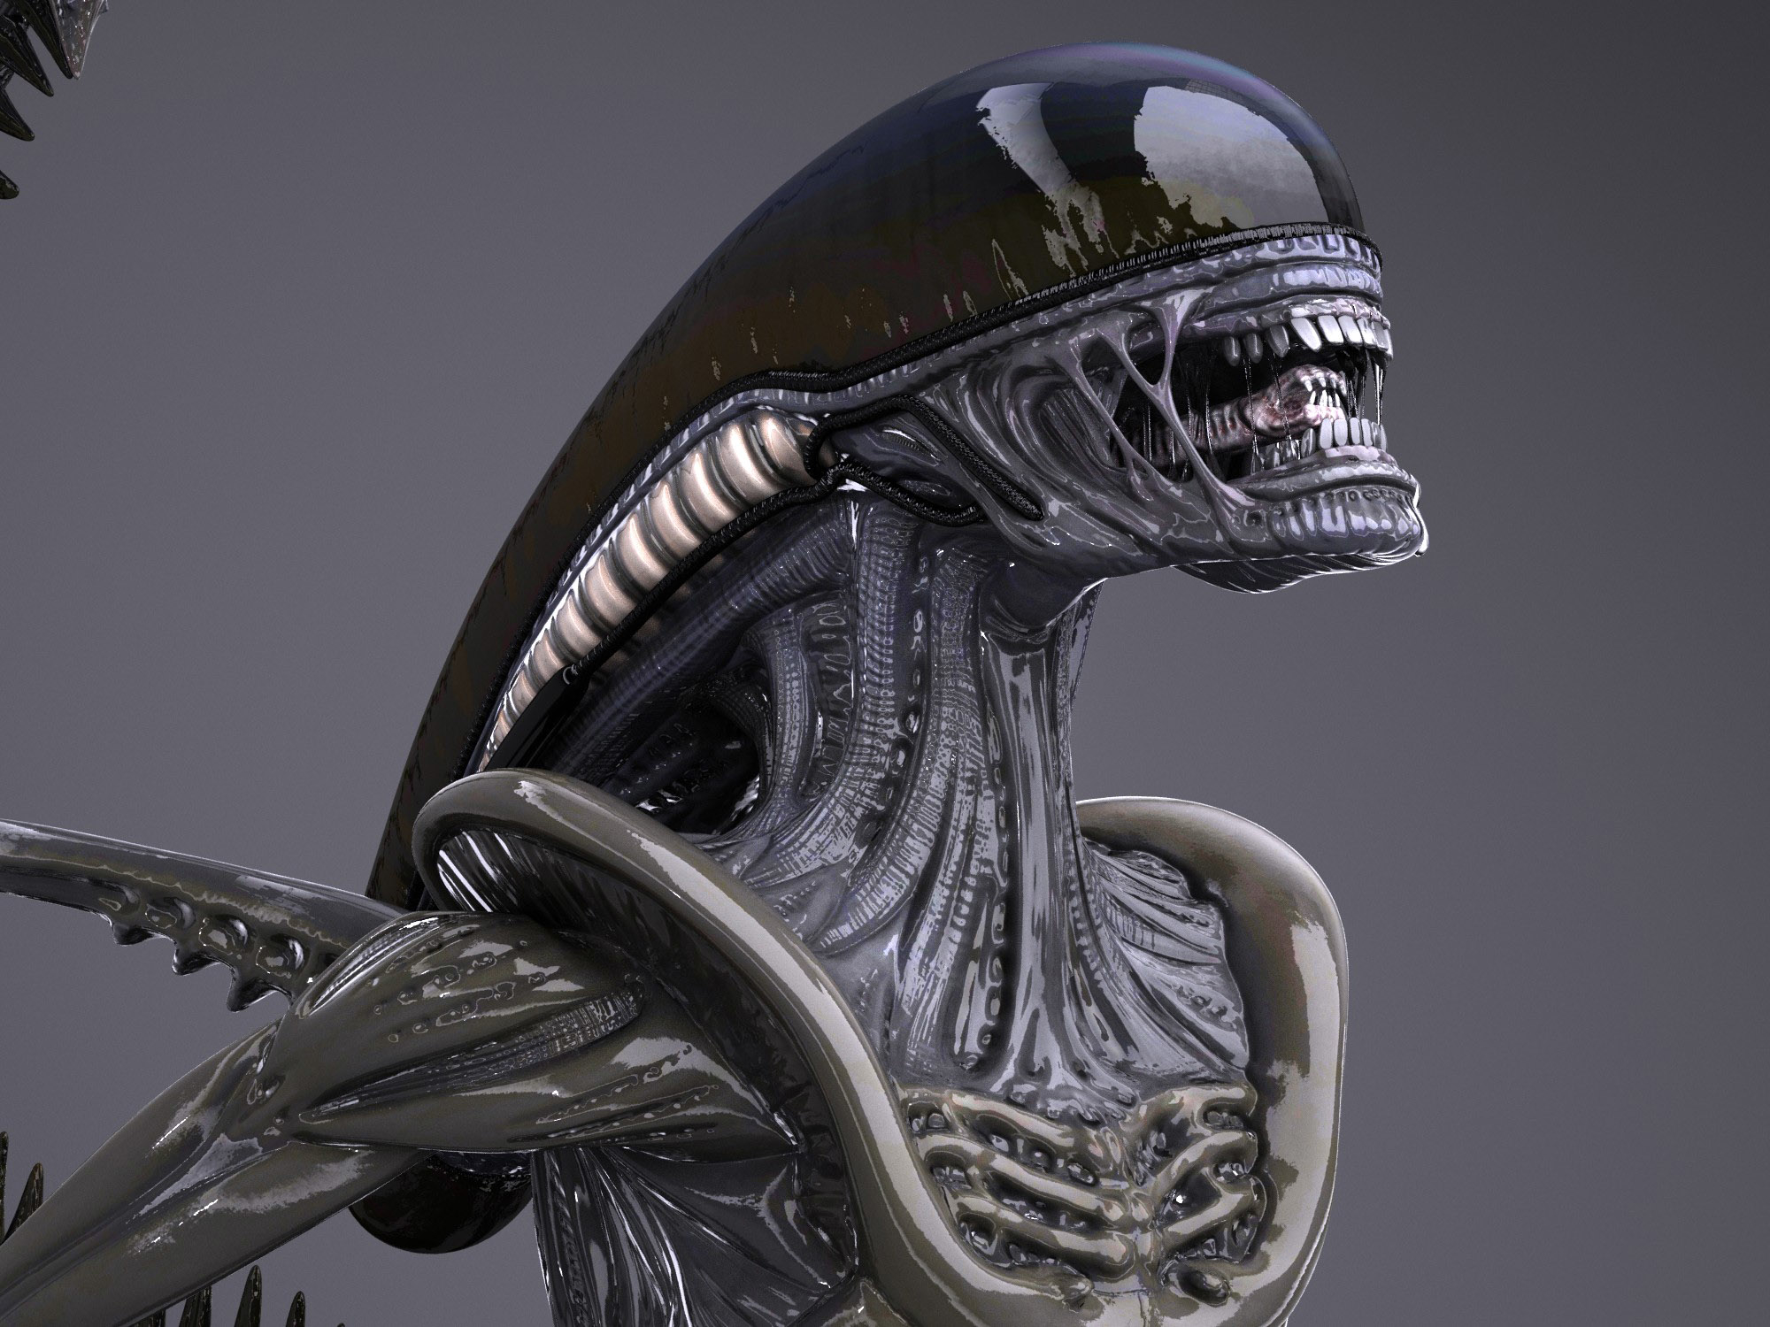
☺English project ☺
The video comes from:
https://l.facebook.com/l.php?u=https%3A%2F%2Fwww.youtube.com%2Fwatch%3Fv%3DSEIsQsfNrw4%26feature%3Dshare%26fbclid%3DIwAR1RFLjWO6HQQy5jWI4AkfMLuO6Gz-xXGYWDxSZdVnhn5MioihPkFeeBntk&h=AT1aJ1qPQvcit_giLdKj2hO-LWya986AKSoC1VVGT71lem0c1gBbrBFpXcYigF_vRYSTt_YJdn_f-8onA40fJ70ZGWKTgV44vqZq1Lh49M0UC8Y0sAU7TJMZ2vbOLEhTXpw07w

Slide 2

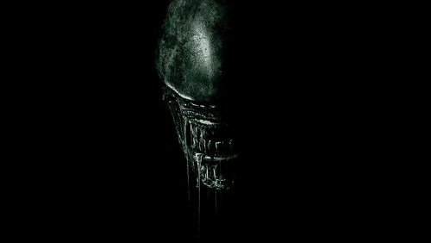
alien
Aliens and the moon landing plan

Slide 3
When it comes to aliens,a lot of pictures properly in everyone’s mind.
For example,Mayan Civilization.Nazca Lines in Peru……and so on.
Let’s investigate the connection between Moon plan and aliens.
To begin with,we have already had the technology to go to the moon since
Armstrond went there in 1969.
But we have never been to the moon from then on.
In recent years,NASA has published a video about Armstrong going to the
movie at that time.
Now let’s take a look:

Slide 4
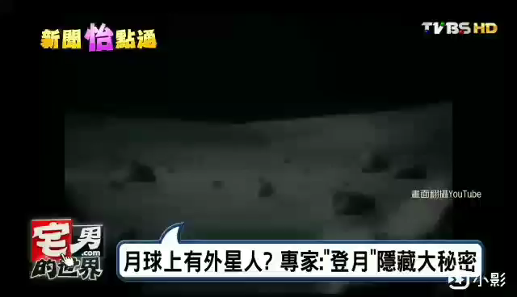

Slide 5
In the video,we can see the scene about broadcasting the Moon-landing.
However,there was an enormous creature,looking like a human being,Without any equipments standing for away in the film.
At that time,Armstrong said”Sir!You won’t belive that I see a huge……”
No sooner had he said at the moment then the message interrupted.It’s a little bit odd,isn’t it?Actually,there were more news about Moon.
Long time ago,America’s and Sovient Union’s astronauts went back from the moon.

Slide 6
From then on,they’re never been there adain.It is said that the aliens seriously warned them not to go to the moon ever after.
According to the pictures from Sovient Union,we found there were some suspected man-made structures on the back of the moon,like the transparent glass-shade castles.moreover,some scientists analyzed the composition of the moon.
They discovered that the moon is not soild,but it’s HOLLOW!This discovery made many people voice several opinions.Some said there’s the high civilization in the moon.
The alien’s technologies are at least a thousand years ahead of us.Some thought the moon always faces to the earth by one side because the aliens are observing us all the time on the side.

Slide 7
It’s been a mystery about one thing~Do the aliens exist in the universe?Although all the data information and pictures above are presently unproven,more and more rumors appear on the Internet,like the alien contast experience!Everyone can carefully think about this incident!
It’s up to your judgement!Nevertheless,our team believe that aliens really exist in the universe!Since we are one of the creatures on the earth,how could this be possible that no aliens on other planets?

Slide 8
experience
This report allowed me to learn "how to attract attention", "importance of choice of report content", "how to show to the crowd" Different from the past, this report has made me a leap in improving the skills of reporting on the stage, and strengthened the skills and proficiency required for presentation.

Slide 9


